Slide 1



Desert Vending
Company
Taking your company to the next level

Slide 2






1. Introduction
Table of contents
2. Problems and solutions
2.1 Products
2.2 Customers
2.3 Employees
2.4 Routes & Visits
3. Conclusions

Slide 3
1. Introduction
Table of contents
2. Problems and solutions
2.1 Products
2.2 Customers
2.3 Employees
2.4 Routes & Visits
3. Conclusions

Slide 4
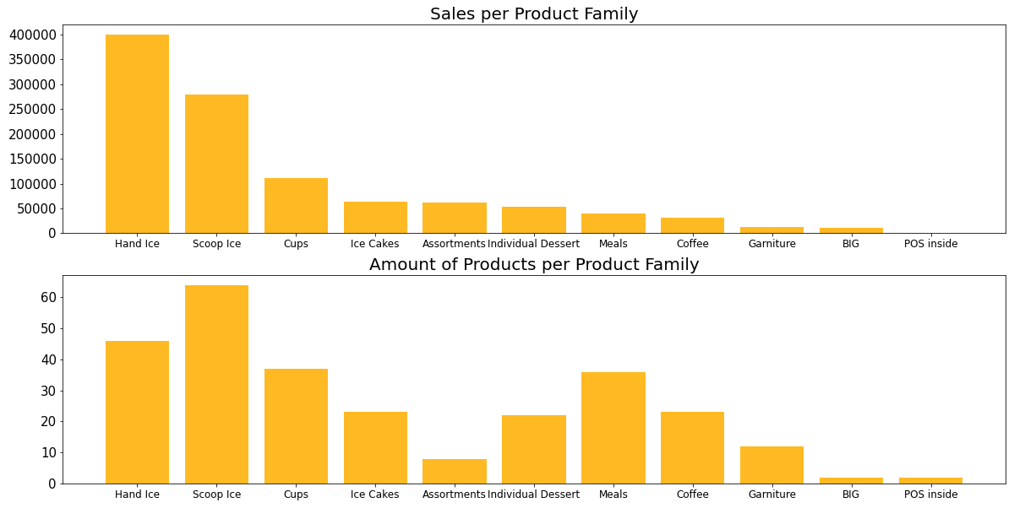
Product family
+Proportion of products in family
Notes:
The top graph shows the total amount of sales for each product family. As you can see I have sorted in a descending way so that the graph is easier to read.
Then I made another plot with the same x-axis, so the same product families. It shows the total amount of different products for each product family.
According to me, it seems interesting to check if these two graphs align, because it is logical to invest, and with investing I mean, creating new products, having a large offer, for the products that generate a lot of revenue.
The red arrow is an example of a product family that can be improved. Meals don't generate a lot of revenue but the company has a lot of different meals, which costs a lot of money. It seems smart to cut some products from the Meals family.
To do that in an effective way, I have created a program that lets you check the proportion of products that are bought in each family. That way you only have to define a threshold (f.e. 0,1) that determines at what proportion the product is cut. In that way you don't cut the most popular products, of course.

Slide 5




Recommendation
Engine
Similar Customers
Correlated Products
Region
Notes:
Next up is the recommendation engine.
With the recommendation engine we created a system that makes it easy for employees to recommend a certain product to a customer in a very specific way.
Our Recommendation Engine takes three things into account. First, it looks at the buying behaviour of similar customers. This is based on recency, frequency and monetary value. It looks for the most similar customer and then it determines the products of that most similar customer.
Secondly, it takes the correlated products of the current customer's products. So these are the products that best fit the current buying behaviour of our customer.
Thirdly and finally, it looks into the region where the customer lives. Our engine looks at the top 5 products of the region where the customer lives.
These three parameters are then compared to each other to see if there are intersections. If there are intersections between the three arrays, we return it. Otherwise we check which parameters have intersections and we return them.
In this way we have a more functional recommendation system.

Slide 6
1. Introduction
Table of contents
2. Problems and solutions
2.1 Products
2.2 Customers
2.3 Employees
2.4 Routes & Visits
3. Conclusions

Slide 7

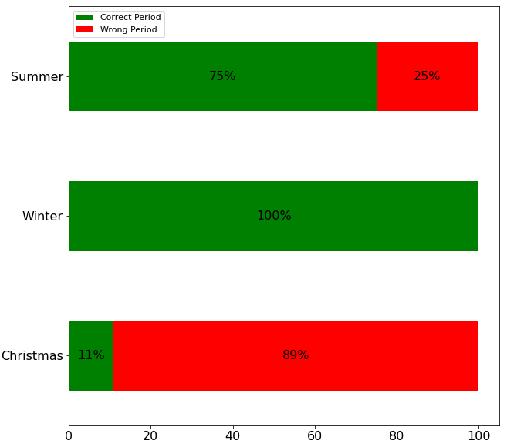

Season type and timing
81%
of the customers that do not open their door, are visited between 9 and 17 P.M.
Notes:
To the left you see the bar chart about the people that opened the door but did not buy anything. We checked if they were visited in their preferred time of the year. The graph speaks for itself. In the Winter it was successful but this was because there is only 1 customer in the winter.
In the Christmas period it is not successful.
The right number gives the percentage of people that did not open their door and are visited between 9 and 17 P.M. This indicates that almost all these people were visited at a time that they are probably not at home. So I would suggest to visit them at a more convenient moment of the day.

Slide 8
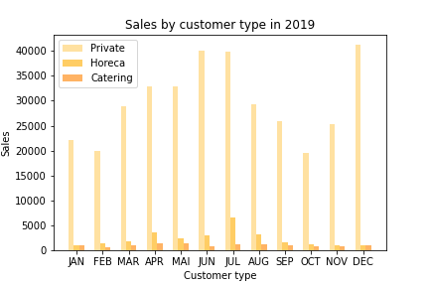
Segments
Notes:
To the left you see the bar chart about the people that opened the door but did not buy anything. We checked if they were visited in their preferred time of the year. The graph speaks for itself. In the Winter it was successful but this was because there is only 1 customer in the winter.
In the Christmas period it is not successful.
The right number gives the percentage of people that did not open their door and are visited between 9 and 17 P.M. This indicates that almost all these people were visited at a time that they are probably not at home. So I would suggest to visit them at a more convenient moment of the day.

Slide 9
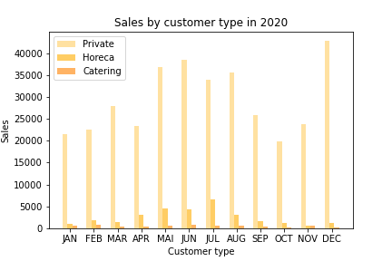
Segments
Notes:
To the left you see the bar chart about the people that opened the door but did not buy anything. We checked if they were visited in their preferred time of the year. The graph speaks for itself. In the Winter it was successful but this was because there is only 1 customer in the winter.
In the Christmas period it is not successful.
The right number gives the percentage of people that did not open their door and are visited between 9 and 17 P.M. This indicates that almost all these people were visited at a time that they are probably not at home. So I would suggest to visit them at a more convenient moment of the day.

Slide 10
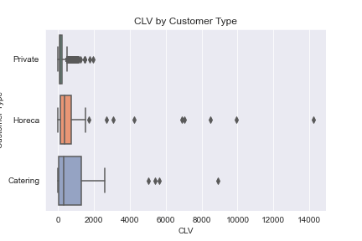
Customer Lifetime Value
Private
Horeca
Catering
5579
97
33
Notes:
To the left you see the bar chart about the people that opened the door but did not buy anything. We checked if they were visited in their preferred time of the year. The graph speaks for itself. In the Winter it was successful but this was because there is only 1 customer in the winter.
In the Christmas period it is not successful.
The right number gives the percentage of people that did not open their door and are visited between 9 and 17 P.M. This indicates that almost all these people were visited at a time that they are probably not at home. So I would suggest to visit them at a more convenient moment of the day.

Slide 11
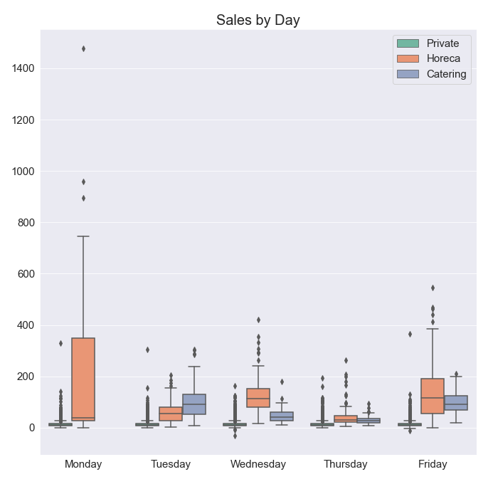
Days of the week
Monday
Tuesday
Wednesay
Thursday
Friday
9108
13678
13994
12693
11774
Notes:
To the left you see the bar chart about the people that opened the door but did not buy anything. We checked if they were visited in their preferred time of the year. The graph speaks for itself. In the Winter it was successful but this was because there is only 1 customer in the winter.
In the Christmas period it is not successful.
The right number gives the percentage of people that did not open their door and are visited between 9 and 17 P.M. This indicates that almost all these people were visited at a time that they are probably not at home. So I would suggest to visit them at a more convenient moment of the day.

Slide 12
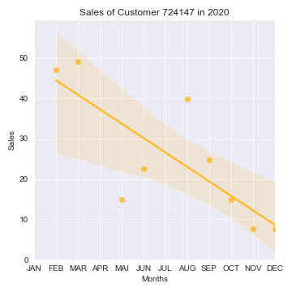
Leaving customers
1225
Solution: coupon
Notes:
To the left you see the bar chart about the people that opened the door but did not buy anything. We checked if they were visited in their preferred time of the year. The graph speaks for itself. In the Winter it was successful but this was because there is only 1 customer in the winter.
In the Christmas period it is not successful.
The right number gives the percentage of people that did not open their door and are visited between 9 and 17 P.M. This indicates that almost all these people were visited at a time that they are probably not at home. So I would suggest to visit them at a more convenient moment of the day.

Slide 13
Reviews
52%
88%
of the customers that gave a bad review in 2019 are leaving customers in 2020 according to our regression
of the customers that gave a terrible review in 2019 are leaving customers in 2020 according to our regression

Slide 14
1. Introduction
Table of contents
2. Problems and solutions
2.1 Products
2.2 Customers
2.3 Employees
2.4 Routes & Visits
3. Conclusions

Slide 15
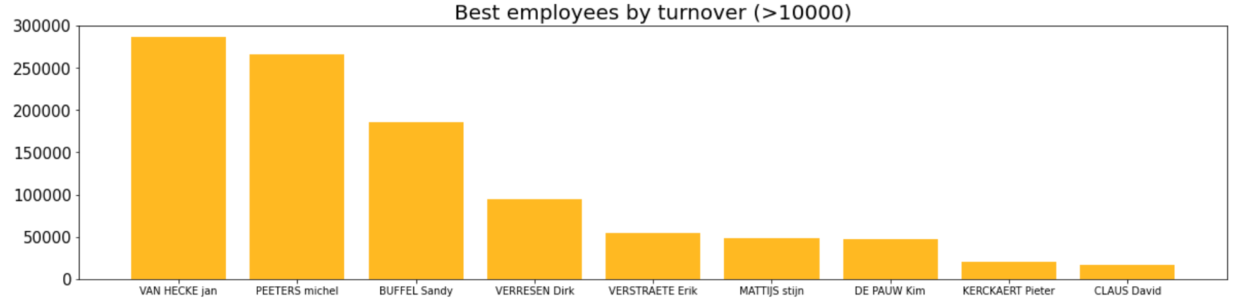
Top 9 employees
Thank
you!

Slide 16
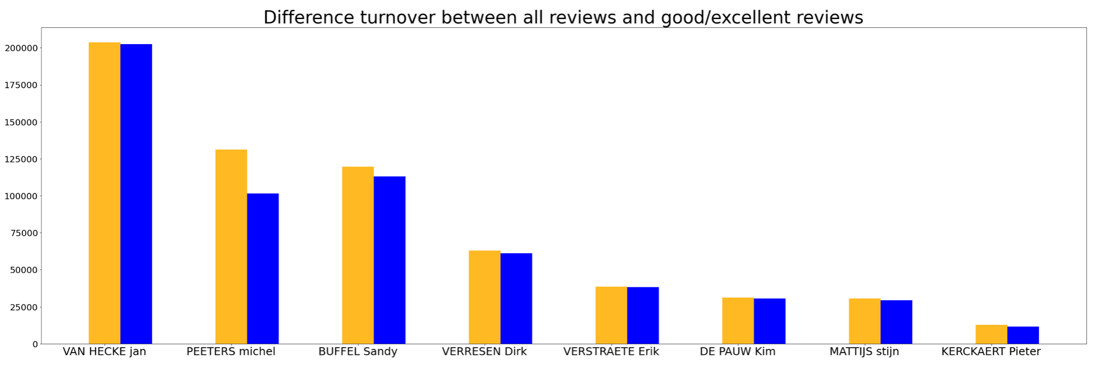
GOAL
Getter
59,5%

Slide 17
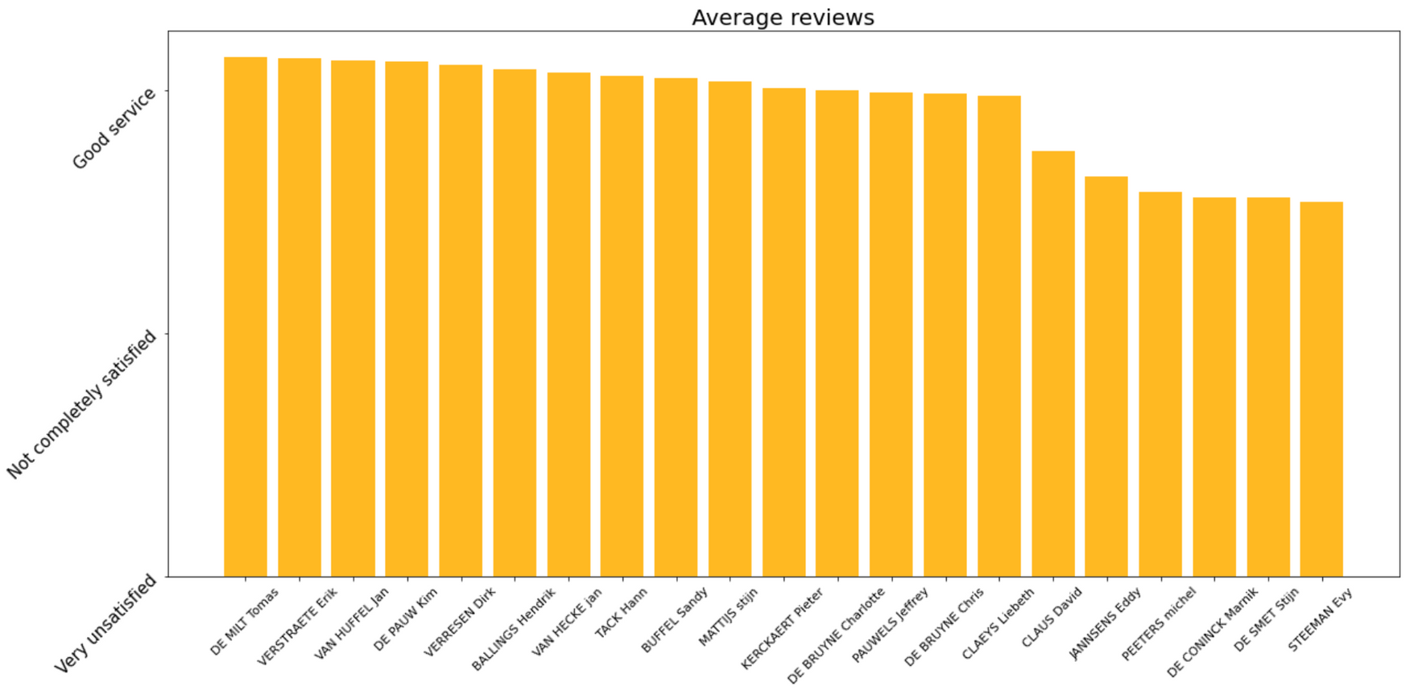
3,13/4
2,58/4

Slide 18
1. Introduction
Table of contents
2. Problems and solutions
2.1 Products
2.2 Customers
2.3 Employees
2.4 Routes & Visits
3. Conclusions

Slide 19
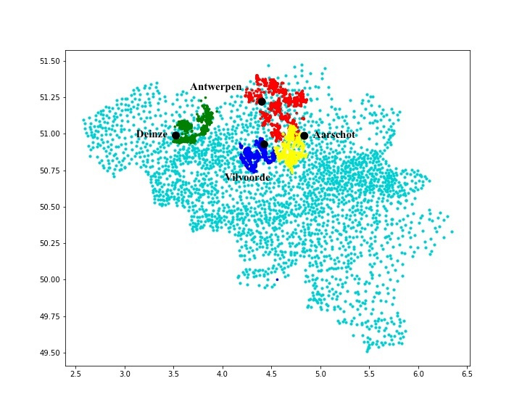


Routes & Visits
Notes:
1. Customer locations in the region of B25 and C17 are overlapping -> solved this by using Kmeans, the routes are now more efficient
The region B25 is smaller and the region C17 larger
More customers to visite in region C17 so more employees are needed there

Slide 20
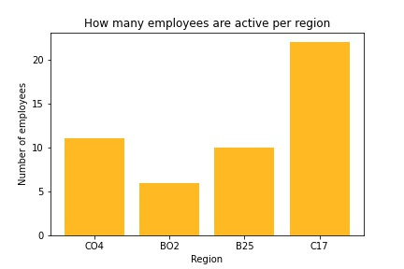
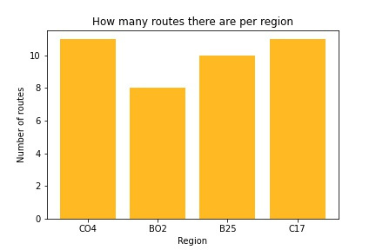
Employee routes
Notes:
The most interesting finding is that there are almost double the amount of employees active in region C17 as in B25.
There are almost as many croutes to be ridden in both regions
Employees in region B25 are overloaded with work while the employees in C17 are with too much in respect to the amount of customers needed to be served.

Slide 21
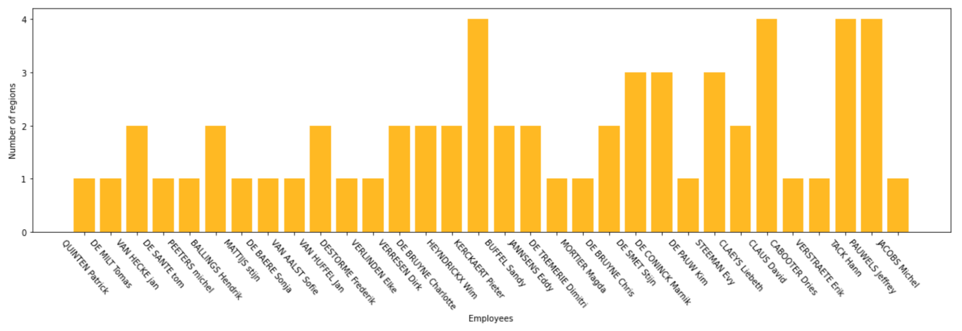

21,9%
of the employees are assigned to 3 or more regions
Notes:
I've made a function where you can see to which region an employee is assigned and how many routes it has per region
Some employees only serve one route per region -> problem
So we can reduce the travel time of an employee

Slide 22
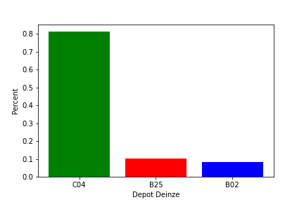
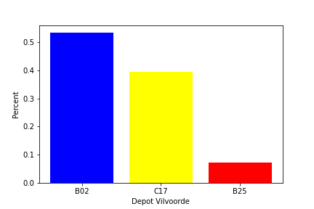
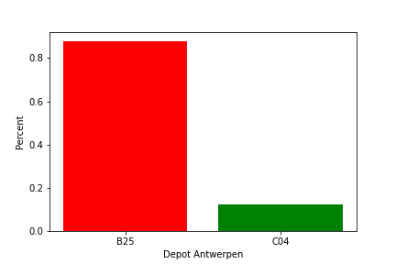
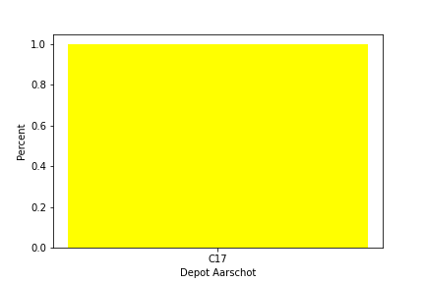
Depots
Notes:
Depot in Deinze is for 80% assigned to the routes in region C04 etc.
It would be better the allocate the region B25 to Depot Antwerpen so Depot Antwerpen is fully in charge of the region B25

Slide 23
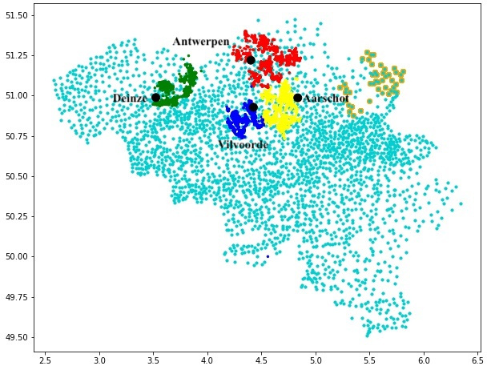
Depots
Notes:
They first have to go to the depot and from there on they start their journey
Move the depot Deinze and Antwerpen so It would be more efficient for the employees

Slide 24
1. Introduction
Table of contents
2. Problems and solutions
2.1 Products
2.2 Customers
2.3 Employees
2.4 Routes & Visits
3. Conclusions

Slide 25

Conclusion
1
Products
2
Customers
3
Employees
4
Routes

Slide 26
Lennert Van den Broeck
Mathew Ugwu
Thank you for listening
Wouter Dewitte
Guillaume Lambert
Master Business Engineering: Data Analytics
-
Analytical Customer Relationship Management

